Slide 1
Shift Operations
Logical left shift
Arithmetic(signed) left shift
Logical right shift
Arithmetic(signed) right shift
Circular left shift (rotate left)
Circular right shift (rotate right)

Slide 2
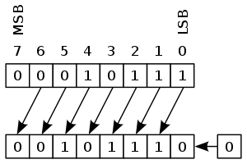
Logical left shift
Arithmetic left shift
https://en.wikipedia.org/wiki/Logical_shift
https://en.wikipedia.org/wiki/Arithmetic_shift

Slide 3
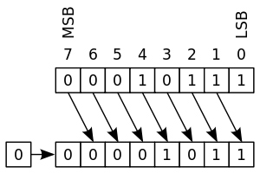
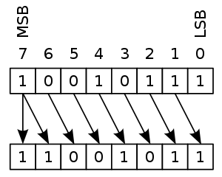
Logical right shift
Arithmetic right shift
https://en.wikipedia.org/wiki/Logical_shift
https://en.wikipedia.org/wiki/Arithmetic_shift

Slide 4
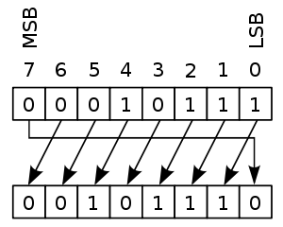
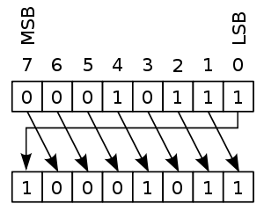
Circular left shift
Circular right shift
https://en.wikipedia.org/wiki/Circular_shift

Slide 5
sel | operation
000 | noshift
001 | logical left shift
010 | arithmetic left shift
011 | logical right shift
100 | arithmetic right shift
101 | rotate left
110 | rotate right
111 | noshift

